Slide 1

Deep Audiobook Tuner
St. Francis Institute of Technology
Department of Computer Engineering
Group Members
Name | Roll No.
Daniel Lobo | 07
Jenny Dcruz | 16
Smita Deulkar | 19
Leander Fernandes | 20
Deep Audiobook Tuner

Slide 2

Content
Introduction
Literature Review
Problem definition
Proposed solution
Experimental setup
Work done so far
Conclusion
References

Slide 3
Introduction
Musical scores are a vital part of any form of entertainment.
There has been major advancements in music generation using artificial intelligence.
Audio books are preferred over reading books. Most audiobooks do not include background music due to issues of copyright infringements and licensing costs. Furthermore, it's not feasible to create musical scores for every audiobook.
At audiobook sites like Audible and LibriVox, these recordings number in the hundreds of thousands.

Slide 4
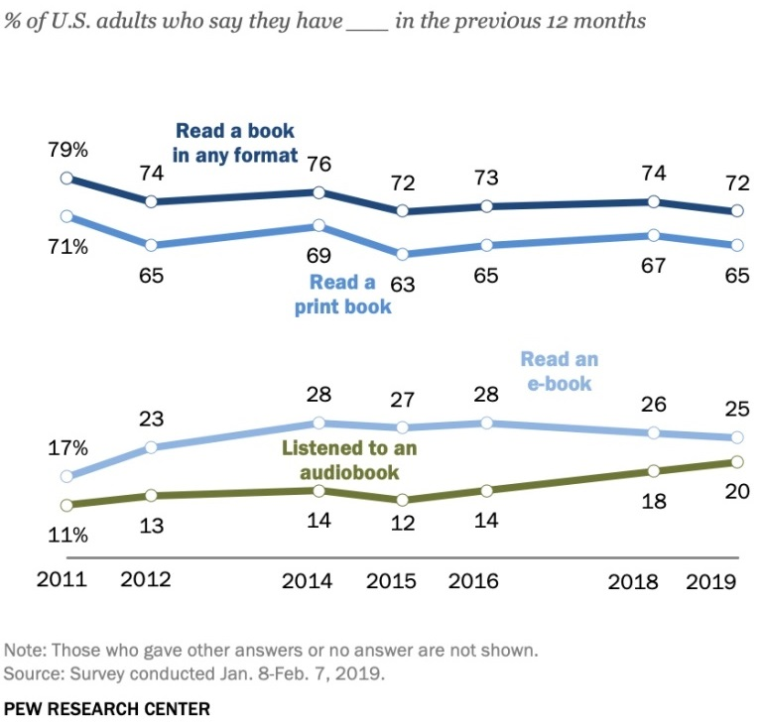
Introduction
In 2013, users downloaded over 500 million hours of audiobooks from Audible alone, nearly 15% of Americans listened to an audiobook every month. As of 2019, this number has grown to 20% and shows a continuous growing trend.
Our project aims to create an easily accessible, efficient, and cost effective application to generate emotionally relevant musical scores for audio books.

Slide 5
Literature Review
Sentiment Analysis of Text
C.J. Hutto and Eric Gilbert [7] describe the development, validation, and evaluation of VADER in their paper.
VADER sentiment analysis relies on a dictionary that maps lexical features to emotion intensities known as sentiment scores.
VADER differentiates itself from other sentiment lexicons such as LIWC in that it is more sensitive to sentiment expressions in social media contexts while also generalizing more favorably to other domains.

Slide 6
Literature Review
Sentiment Analysis of Audio files
Navas, Eva, Inma Hernez, and Iker Luengo [4] have shown that prosodic features and acoustic features such as power and pitch contribute to the sentiment variation. By incorporating these audio features of the accompanying speech, the capability of the model to recognize the context can be increased.
Arpit Shah and Shivani Firodiya [3] used acoustic features such as MFCC, STFT, Contrast, Mel Spectrum, Chroma and Tonnetz extracted from the audio clips of the RAVDESS dataset to train their fully connected DNN model for sentiment analysis on audio.

Slide 7
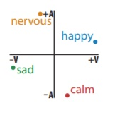
Literature Review
Classification of sentiments or emotions can be achieved through different measures. A popular approach is Russell's circumplex model [5] which classifies emotions based on their valence and arousal values. The valence dimension indicates whether an emotion is positive or negative, whereas arousal indicates the intensity of the emotion.

Slide 8
Literature Review
Working with MIDI files
MIDI files explain what notes are being played as they are played, along with the duration and intensity of each note [6]. MIDI files are instructions for how the music should be produced, when a program tries to interpret the file. Advantages of MIDI include small file size, ease of modification and manipulation and a wide choice of electronic instruments and synthesizer or digitally-sampled sounds.

Slide 9
Literature Review
Generation of Emotional music
Generating emotionally relevant music for videos and books is a problem that people have attempted to solve in different ways. A common approach for this problem consists of designing a rule-based system to map musical features to a given emotion in a categorical or dimensional space [1]. Steve Rubin and Maneesh Agrawala [2] proposed a system that would resequence music files in order to create a soundtrack that conveys the emotion perceived from an audio book.
Ferreira and Whitehead [1] have presented a generative mLSTM model that can be controlled to generate symbolic music with a given sentiment. Their model had been trained on a corpus of MIDI files.

Slide 10
Problem definition
“To develop a machine learning system that takes an audiobook (mp3 file) as an input, analyzes the sentiments conveyed through the script and generates emotionally relevant music sequences. As the emotions conveyed through the script vary, the model will smoothly adapt to the emotional changes and provide a musical score that compliments the audiobook.”

Slide 11
Proposed Solution
Our system consists of two models, sentiment analysis model and a music generation model.
The initial model will take an audio book file (script, audio) as it's input .
It will segment the script.
Individual segments are processed and topics are extracted from them.
The sentiment for each segment is analyzed from the clusters of topics extracted.
These sentiments are passed on as the input to the music generation model.

Slide 12
Proposed Solution
In the second model, music is generated and the sentiments are an important factor in adjusting the components of our model.
Sentiment is perceived in music due to several features such as melody, harmony, tempo, timbre, etc. Quieter volume, slower tempo and lower pitch is found to convey the emotion of sadness whereas louder volume, faster tempo and higher pitch is perceived as happier.

Slide 13
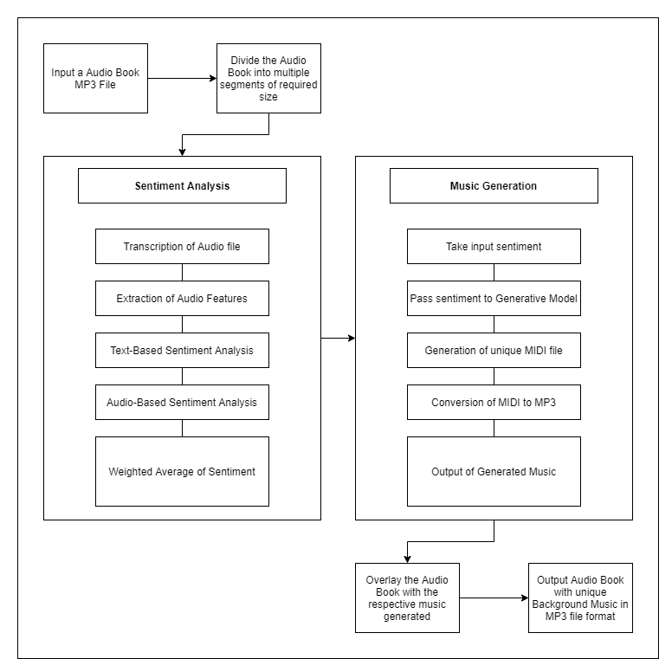
System Block Diagram

Slide 14
Experimental Setup:
Software Requirements:
Operating System: Windows 10
Python 3
Hardware Requirements:
CPU: Intel i5/Ryzen 5 or above
Clock speed: 2.5 GHz or above
GPU: NVIDIA Geforce GTX 960 or above
RAM size: 8GB or above
Hard Disk capacity: 100GB or above

Slide 15
Experimental Setup:
Datasets:
RAVDESS Emotional speech audio (Emotional speech dataset for training audio based sentiment analysis) <https://www.kaggle.com/uwrfkaggler/ravdess-emotional-speech-audio>
VGMIDI Dataset (Emotional music dataset for training music generation model) <https://github.com/lucasnfe/vgmidi/tree/master/midi>
Agendaweb Audio books (Audiobook dataset for testing)<https://agendaweb.org/listening/audio-books-mp3.html>
Output:
MP3 file of audiobook with generated background music

Slide 16
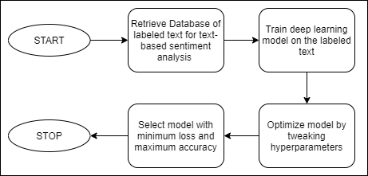
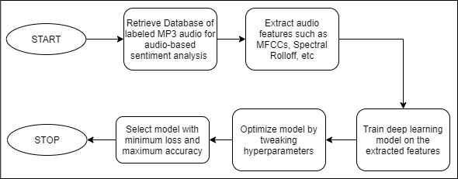
Work done so far
Workflow for training Text-based sentiment analysis model
Workflow for training Audio-based sentiment analysis model

Slide 17
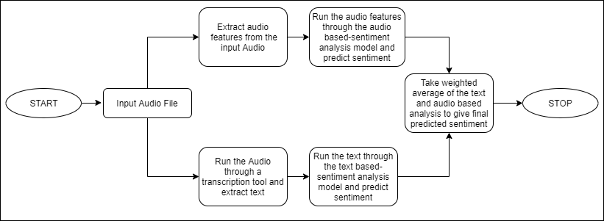
Work done so far
Workflow for Final sentiment analysis model

Slide 18
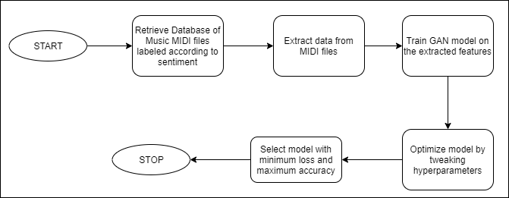
Work done so far
Workflow for training sentiment relevant Music Generation Model

Slide 19
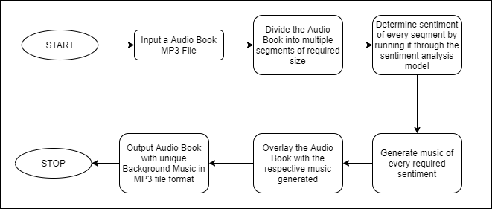
Work done so far
Workflow of Client-end Software

Slide 20
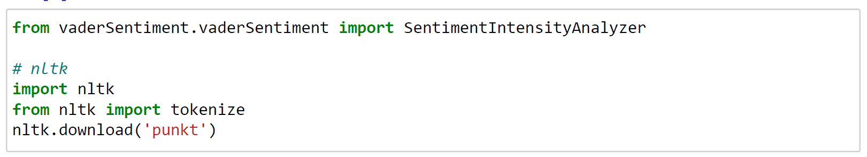
Work done so far
Imports for IBM Watson’s Speech to Text Transcription
Imports for Vader - Text Sentiment Analysis
Workflow of Client-end Software

Slide 21
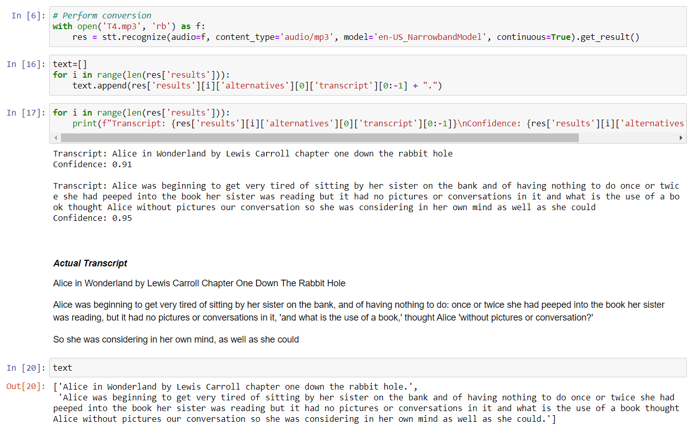
Work done so far
IBM Watson’s Speech to Text Transcription

Slide 22
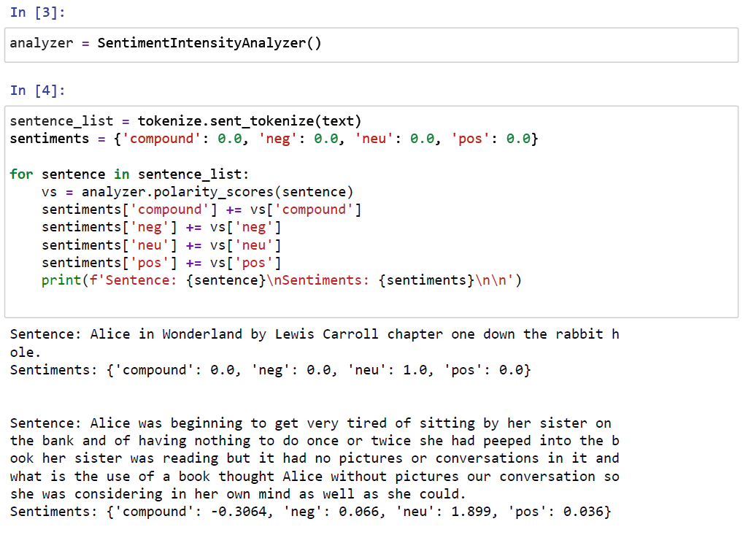
Work done so far
Vader - Text Sentiment Analysis

Slide 23
Conclusion
High-quality narrations are integral to creating captivating digital content, but most audio books do not have background musical scores. The few that do have it are expensive as it a tedious task to create a soundtrack for it. Our proposed system can generate emotionally relevant scores which are cost effective, efficient and easily accessible to authors who want to add a soundtrack to their audiobook.

Slide 24
References
[1] Lucas N. Ferreira, Jim Whitehead. “Learning to Generate Music With Sentiment”, 20th International Society for Music Information Retrieval Conference, Delft, The Netherlands, 2019.
[2] Steve Rubin and Maneesh Agrawala. 2014. “Generating emotionally relevant musical scores for audio stories”. In Proceedings of the 27th annual ACM symposium on User interface software and technology (UIST '14). Association for Computing Machinery, New York, NY, USA, 439–448.
[3] Arpit Shah, Shivani Firodiya, “Audio Sentiment Analysis after a Single-Channel Multiple Source Separation.” Indiana University Bloomington.

Slide 25
References
[4] Navas, Eva, Inma Hernez, and Iker Luengo. “An objective and subjective study of the role of semantics and prosodic features in building corpora for emotional TTS.” IEEE transactions on audio, speech, and language processing 14.4 (2006).
[5] Russell, J. A. A circumplex model of affect. Journal of personality and social psychology 39, 6 (1980), 1161.
[6] Tim Fisher, 2020, What Is a MIDI File?, Lifewire, accessed 30 October 2020, <https://www.lifewire.com/midi-file-2621979>

Slide 26
References
[7] C.J. Huttom, Eric Gilbert, “VADER: A Parsimonious Rule-based Model for Sentiment Analysis of Social Media Text”, Association for the Advancement of Artificial Intelligence (www.aaai.org). 2014.

Slide 27
Thank you

